Slide 1
NIT2202-Big Data Introduction
HENU-2022秋
Tao Xu

Slide 2
Lecturers： Ayman abaida (ayman.ibaida@vu.edu.au) 许涛（txu@henu.edu.cn）
许涛： session1-9
Ayman：session10-12
学习大数据的理论、技术，
获得处理大数据的技能，
锻炼解决大数据问题的能力。

Slide 3
Learning Outcomes
三条学习路线
大数据理论：经典教材 + AWS云平台理论
大数据技术：AWS云平台技术 + Tableau数据可视化技术
预备知识与扩展：数据库技术+编程技术+AWS线上数据分析课程（DAF）
On successful completion of this unit, students will be able to:
Analyse and illustrate Big Data challenges to the business world;
Explain the impact of Big Data's five V’s (Volume, Velocity, Variety Veracity and Value) using real world examples;
Apply architectural components and programming models of commonly used Big Data; and
Install and execute a technological solution using open-source software framework.

Slide 4
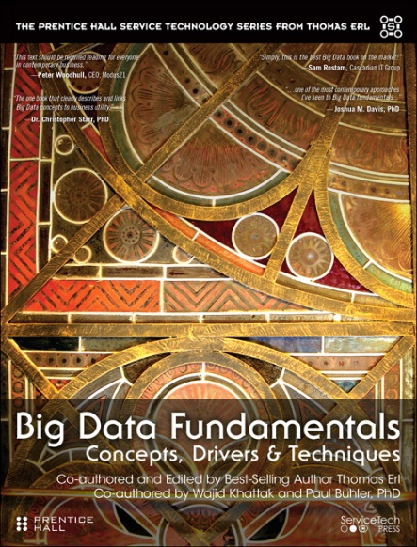
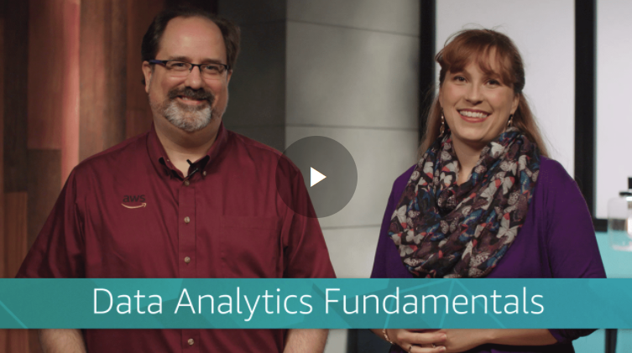
课程读物
Big Data Fundamentals: Concepts, Drivers & Techniques: Concepts, Drivers and Techniques AUTHORS: Thomas Erl, Wajid Khattak, Paul Buhler
ISBN13: 9780134291079
Free Access to e-Book:
https://learning.oreilly.com/library/view/big-data-fundamentals/9780134291185/
国内免费访问：
道客巴巴，下载稻壳阅读器查看。
NIT2202 Tests are based on the Textbook and AWS Labs.
Reference:
AWS Data Analytics Fundamentals (DAF),
https://www.aws.training/Details/eLearning?id=35364
especially Lesson 5 & 6 are useful to Group Assignment
DAF中文版介绍正在制作，后期将陆续发布。

Slide 5
Assessments
过程性考核，没有期末考试，但要求更高，难度更大。
Type | Task | Session | Format | 说明
Laboratory Work (30%) | Lab 1+2+3 (9%) Tableau Lab (6%) Lab 4+5 (6%) Lab 6+7+8 (9%) | 3 5 6 9 | Practical Assessment FULL Screen including top ASW user identifier and bottom of Taskbar date & time captures of required Labs | 前9周，每周一个，共9个lab VU Space Dropbox 4次提交
Group Assignment (30%) | Individual Live Demo (15%) Team Presentation (15%) | 10-12 | Individual Live Demo PPT team presentation full-length attendance required No show No marks No submission No marks | >两人一组， >在AWS实验平台完成案例实践， >完成个人演示和小组报告
Tests (40%) | Test 1 (20%) Test 2 (20%) | 7 11 | Chapters 1-4 & Labs 1-4 Chapters 5-8 & Labs 5-8 Tests based on the Textbook & AWS Labs 10 MCQs and 4 Written Questions | >两次线上测试（VU Quizzes）

Slide 6
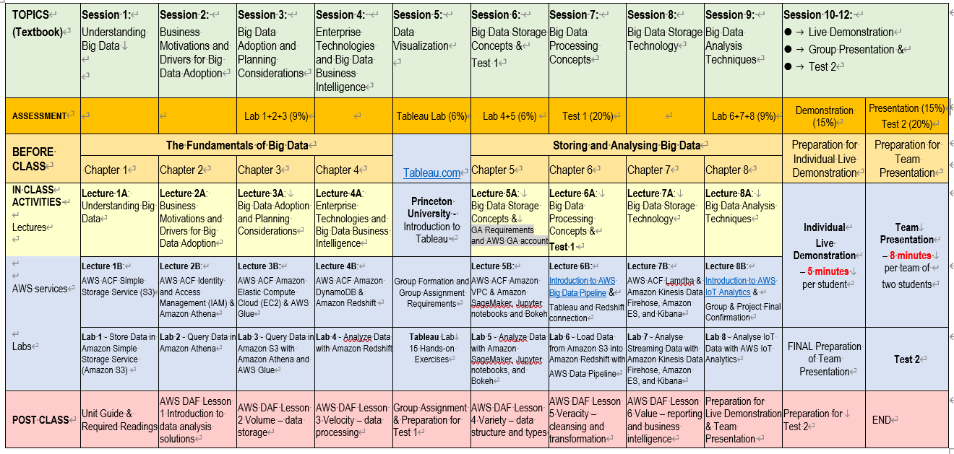

Slide 7
AWS Academy Day Analytics
In NIT2202 Big Data, the unit integrates the eight Labs from AWS Academy Day Analytics (ADA) developed by AWS Academy so that students will gain the real-world experience through AWS (Amazon Web Services) Live System. NIT2202 Group Assignments are also conducted on AWS Academy Learner’s Lab.
However, AWS makes weekly Featured Announcements, ADA’s Lab Manuals cannot keep up the pace with it!!!
Please do spend time to explore if you cannot locate some menus while doing labs …
Notes:
AWS Certification helps learners build credibility and confidence by validating their cloud expertise with an industry-recognized credential. It also helps organizations identify skilled professionals who can lead cloud initiatives by using AWS.
You must earn a passing score by taking a proctored exam to earn an AWS certification. After receiving a passing score, you will receive your certification credentials.
AWS Certification does not publish a list of all services or features that are covered in a certification exam. However, the exam guide for each exam lists the current topic areas and objectives that are covered in the exam. You can find exam guides on the Prepare for Your AWS Certification Exam webpage.
You will be required to update your certification (or recertify) every 3 years. View the AWS Certification Recertification page for more details.
The information on this slide is current as of June 2020. However, exams are frequently updated. Also, the details regarding which exams are available—and what is tested by each exam—are subject to change.
For the newest AWS certification exam information, go to AWS Certification.

Slide 8
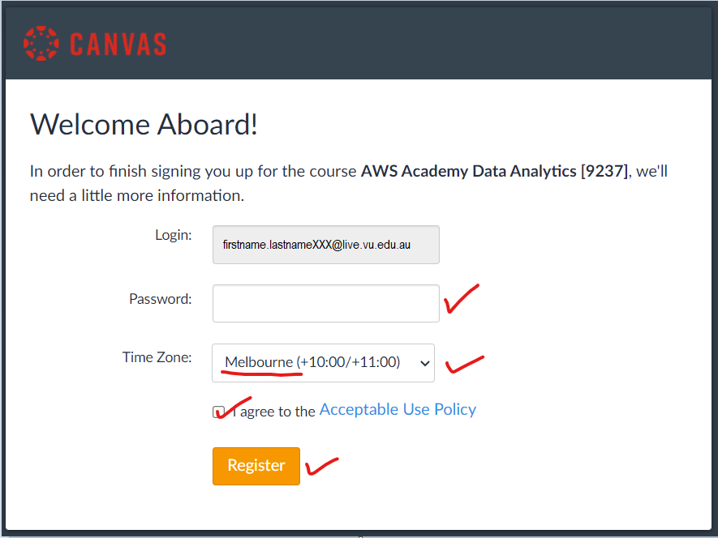
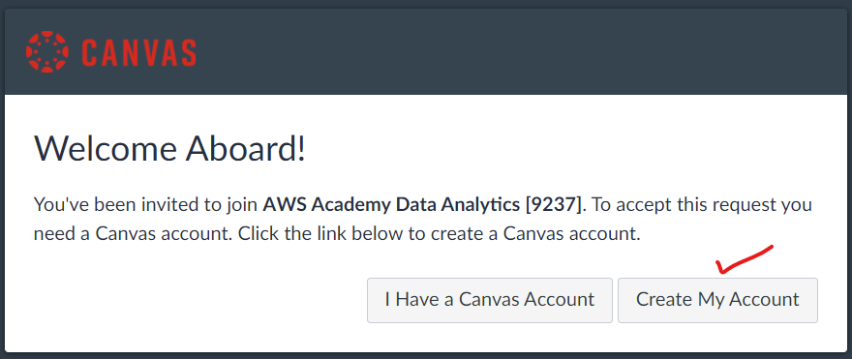
Web Interface
After you accept an invitation from AWS Academy notifications@instructure.com, visit https://awsacademy.instructure.com and click on “Student Login”.
If you haven’t got a Canvas Account, click on “Create My Account”.
Then create a Password and change Time Zone in the next window.
Notes:
AWS Certification helps learners build credibility and confidence by validating their cloud expertise with an industry-recognized credential. It also helps organizations identify skilled professionals who can lead cloud initiatives by using AWS.
You must earn a passing score by taking a proctored exam to earn an AWS certification. After receiving a passing score, you will receive your certification credentials.
AWS Certification does not publish a list of all services or features that are covered in a certification exam. However, the exam guide for each exam lists the current topic areas and objectives that are covered in the exam. You can find exam guides on the Prepare for Your AWS Certification Exam webpage.
You will be required to update your certification (or recertify) every 3 years. View the AWS Certification Recertification page for more details.
The information on this slide is current as of June 2020. However, exams are frequently updated. Also, the details regarding which exams are available—and what is tested by each exam—are subject to change.
For the newest AWS certification exam information, go to AWS Certification.

Slide 9
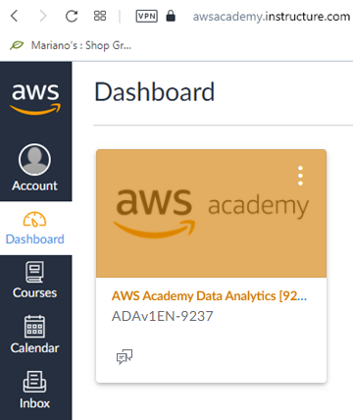
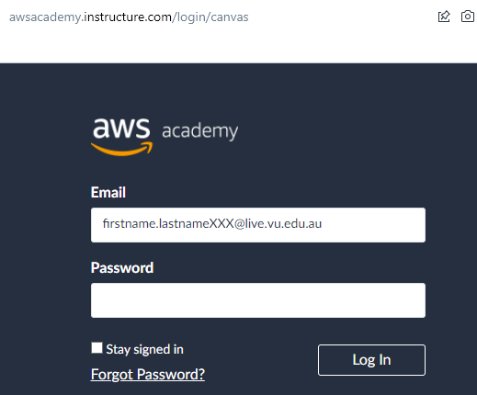
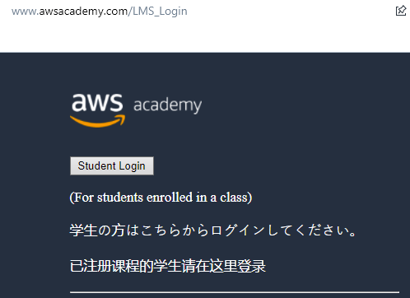
Web Interface
Once you login, you will see the AWS Academy Data Analytics [ADAv1EN-XXXX] course on the dashboard.
If you forgot your password, click on “Forgot password?” Check your email account and follow through to set a new password.
Notes:
AWS Certification helps learners build credibility and confidence by validating their cloud expertise with an industry-recognized credential. It also helps organizations identify skilled professionals who can lead cloud initiatives by using AWS.
You must earn a passing score by taking a proctored exam to earn an AWS certification. After receiving a passing score, you will receive your certification credentials.
AWS Certification does not publish a list of all services or features that are covered in a certification exam. However, the exam guide for each exam lists the current topic areas and objectives that are covered in the exam. You can find exam guides on the Prepare for Your AWS Certification Exam webpage.
You will be required to update your certification (or recertify) every 3 years. View the AWS Certification Recertification page for more details.
The information on this slide is current as of June 2020. However, exams are frequently updated. Also, the details regarding which exams are available—and what is tested by each exam—are subject to change.
For the newest AWS certification exam information, go to AWS Certification.

Slide 10
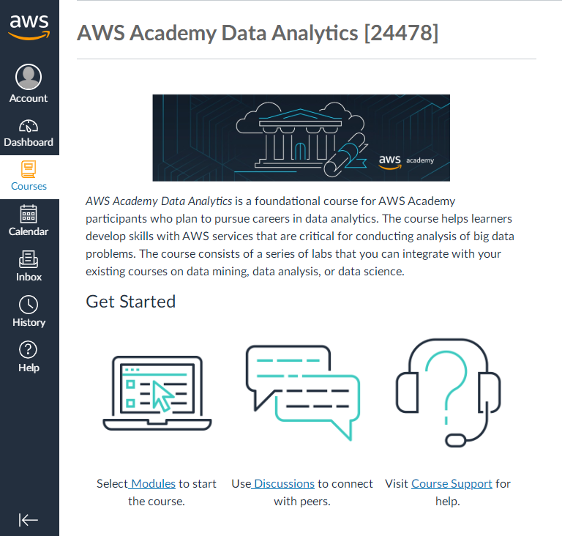

Slide 11
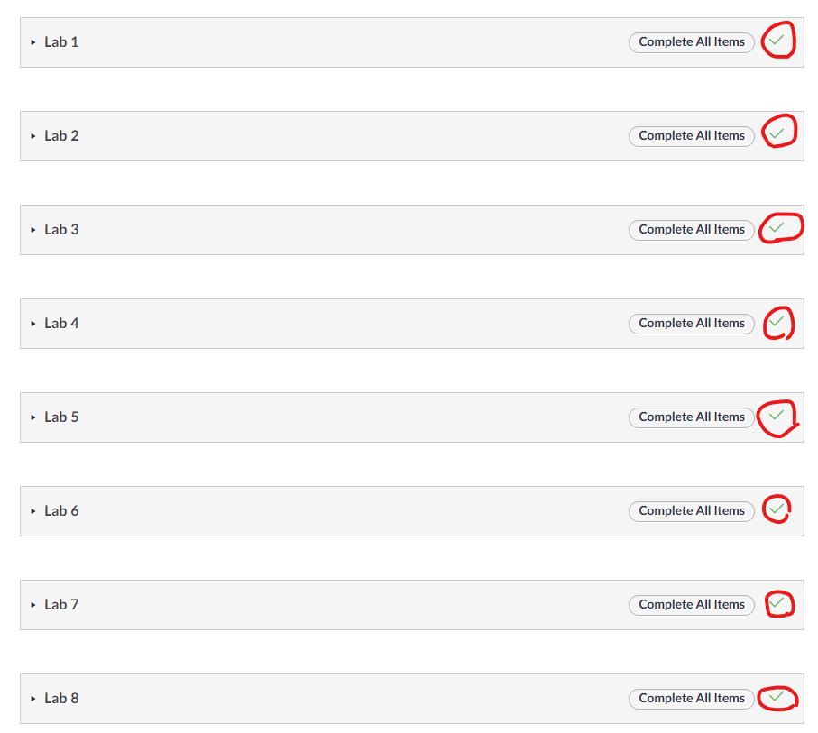

Slide 12
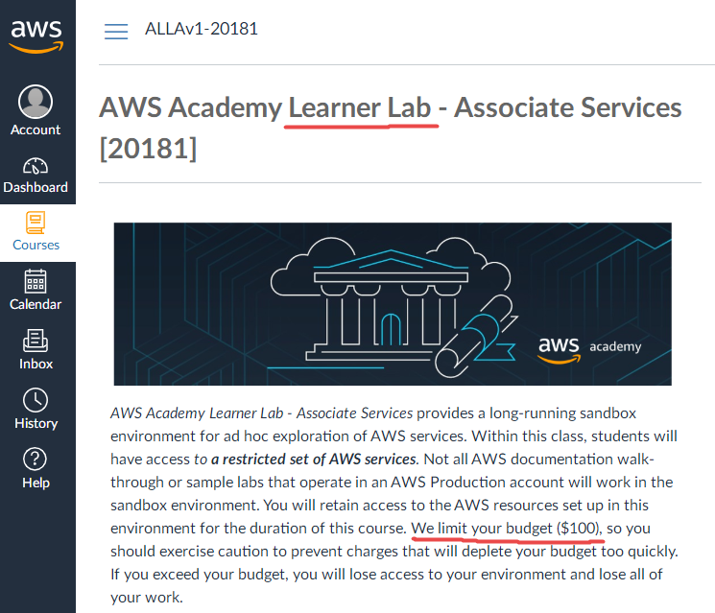

Slide 13


Tableau for Teaching - Student License
Download the latest version of Tableau Desktop & Tableau Prep Builder:
https://www.tableau.com/tft/activation
On the form, enter your university email address for Business E-mail and enter Victoria University for Organization.
3. Activate with a product key provided by your Lecturer, in such a format:
TCLZ-6E45-3B20-CC71-0267
Already have a copy of Tableau Desktop installed? Update your license in the application:
Help menu → Manage Product Keys
Tableau Prep

Slide 14
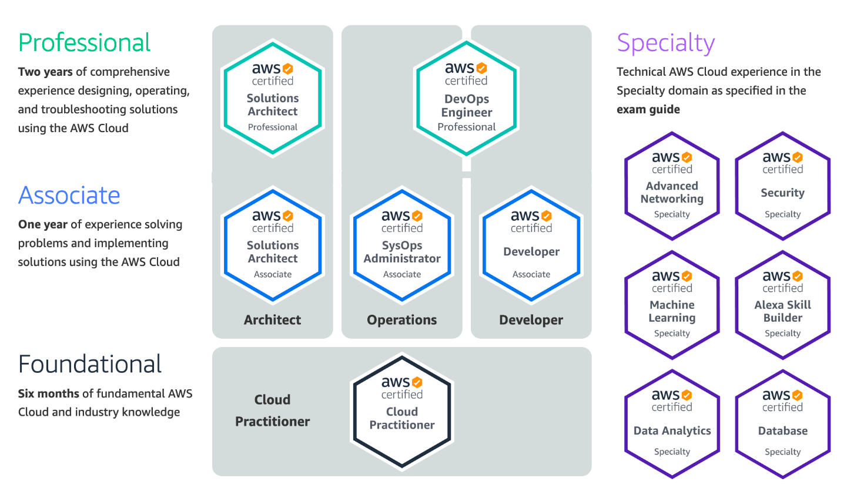
AWS Certification
AWS Training and Certification, https://www.aws.training/
Notes:
AWS Certification helps learners build credibility and confidence by validating their cloud expertise with an industry-recognized credential. It also helps organizations identify skilled professionals who can lead cloud initiatives by using AWS.
You must earn a passing score by taking a proctored exam to earn an AWS certification. After receiving a passing score, you will receive your certification credentials.
AWS Certification does not publish a list of all services or features that are covered in a certification exam. However, the exam guide for each exam lists the current topic areas and objectives that are covered in the exam. You can find exam guides on the Prepare for Your AWS Certification Exam webpage.
You will be required to update your certification (or recertify) every 3 years. View the AWS Certification Recertification page for more details.
The information on this slide is current as of June 2020. However, exams are frequently updated. Also, the details regarding which exams are available—and what is tested by each exam—are subject to change.
For the newest AWS certification exam information, go to AWS Certification.

Slide 15

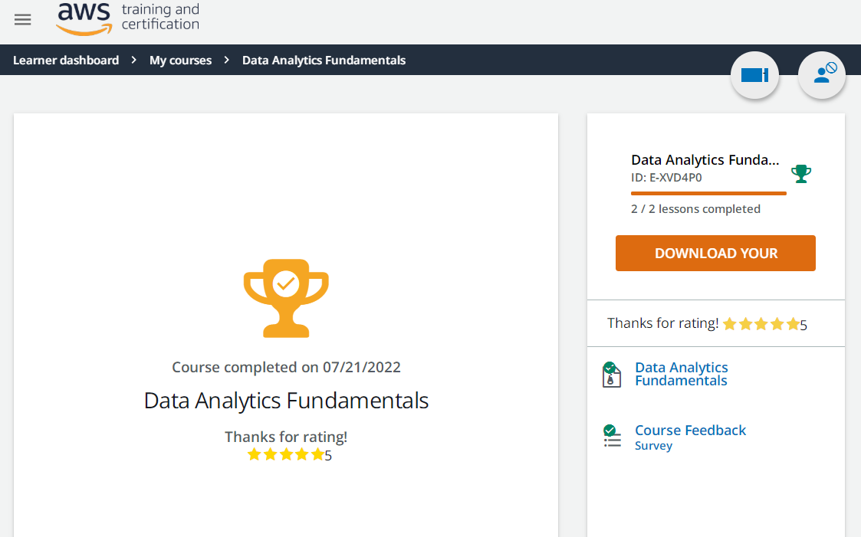
AWS Data Analytics Fundamentals (DAF), https://www.aws.training/Details/eLearning?id=35364

Slide 16
Thanks
NIT2202 Big Data HENU-2022秋

